Slide 1

T1 HACKATHON - USECASE 1: VIRTUAL HEALTH ASSISTANCE
REVIVE.LY
Team Members:
Harish Sanmugam J(18eucs042)
Akash S M(18eucs005)
Jeya Pradeepa K(18eucs051)
Akhilesh R(18eucs007)

Slide 2



TECHNOLOGY STACK
T1 HACKATHON - USECASE 1: VIRTUAL HEALTH ASSISTANCE
FRONT-END TOOLS:-
FLUTTER (Cross-platform mobile development tool)
BACK-END TOOLS:-
FIREBASE (NoSql Database)
VERSION-CONTROL TOOLS:-
GITHUB (Software development tool)

Slide 3
T1 HACKATHON - USECASE 1: VIRTUAL HEALTH ASSISTANCE
ANALYSIS OF USE-CASE DOCUMENT
USERS:-
- Patients
- Hospital administrators
- Doctors(General & specialist)(Healthcare providers)
- Lab Analyst
MUST HAVE FEATURES:-
- Bringing all users under the same roof
- Store user details(User Profile Maintenance)
- Prescription & Appointment Automation
- Patient health report generation and analysis
- Notification alert system
GOOD TO HAVE FEATURES:-
- Report analysis
- Medication reminders
- Discussion forum
- Admin access
- Log maintenance

Slide 4
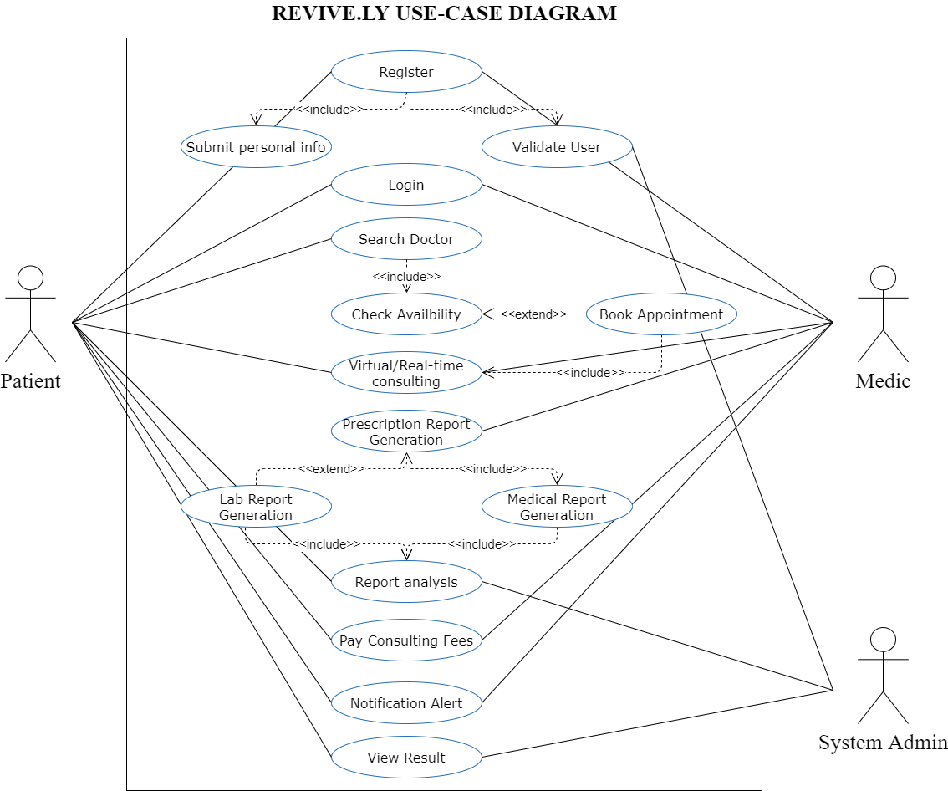
T1 HACKATHON - USECASE 1: VIRTUAL HEALTH ASSISTANCE

Slide 5
T1 HACKATHON - USECASE 1: VIRTUAL HEALTH ASSISTANCE
ROAD-MAP TO BUILD REVIVE.LY
WHAT IS OUR PRODUCT IDEA?
An app that can act as a bridge between Patients and Doctors (Tele-Consultation).
An app that stores Patient’s health data, prescriptions and lab reports for future reference.
An app that uses google calendar (using google calendar API) to schedule/re-schedule appointments with the Doctors.
An app that monitors and analyses Patient’s data and notifies them through e-mail.
WHOM DOES OUR PRODUCT TARGET?
Our product targets the patients across the country who has access to the internet.
Our product targets the pharmacy stores who are willing to establish their stores online.
Our product targets the hospitals and clinics who are willing to offer their services in online healthcare platforms.

Slide 6
T1 HACKATHON - USECASE 1: VIRTUAL HEALTH ASSISTANCE
ROAD-MAP TO BUILD REVIVE.LY
HOW HAVE WE PLANNED TO BUILD IT?
Flutter (Mobile app development)
Firebase (Database management)
Google APIs
Python (Data analysis)
GitHub (Version control)
WHERE DOES OUR PRODUCT FIT IN THE MARKET?
In the current online healthcare market, there are numerous apps that features their functionalities. We have added new features and optimized the design of our app to integrate multiple functionalities into one unified app.

Slide 7
T1 HACKATHON - USECASE 1: VIRTUAL HEALTH ASSISTANCE
ROAD-MAP TO BUILD REVIVE.LY
WHAT IS OUR REVENUE MODEL?*
In-app purchases*
In-app Ads*
WHAT IS OUR SCALE?
Phase 1: Top metropolitan Cities
Phase 2: Urban Cities
Phase 3: Rural Areas

Slide 8
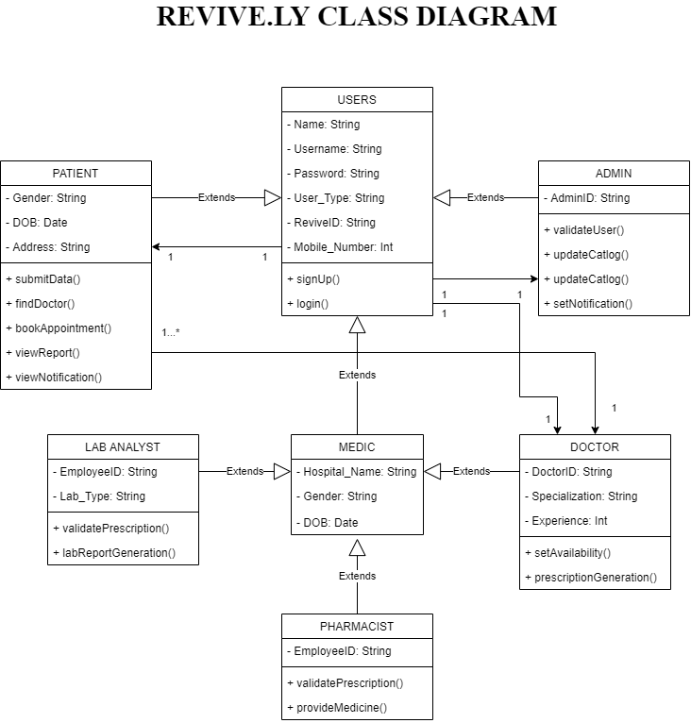
T1 HACKATHON - USECASE 1: VIRTUAL HEALTH ASSISTANCE

Slide 9
T1 HACKATHON - USECASE 1: VIRTUAL HEALTH ASSISTANCE
THANK YOU

